Slide 1
Computer Vision and Deep Learning
Lecture 4

Slide 2
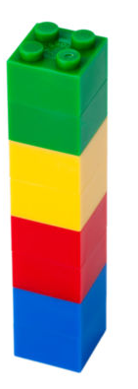
Previously Convolutional neural networks
Convolutional neural networks
Convolutional layers
Pooling layers
Fully connected layers

Slide 3
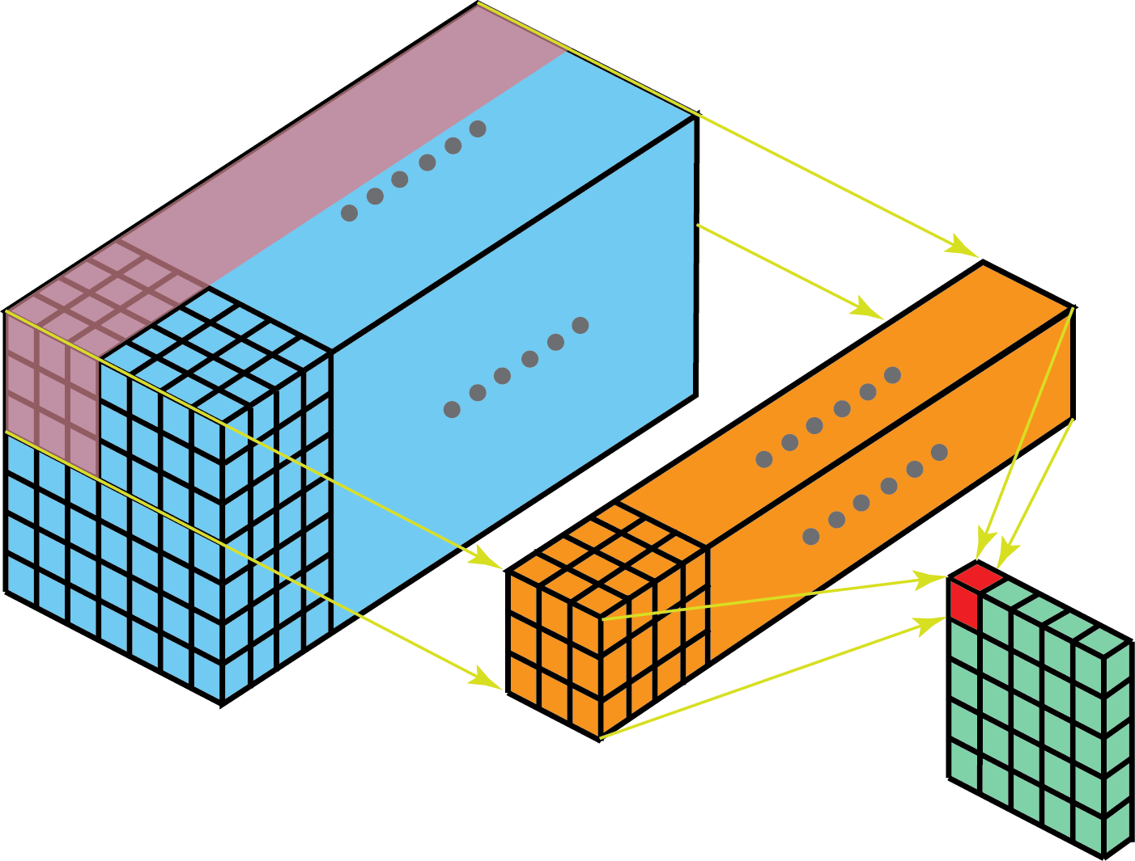
Convolution layers
Shared parameters
Sparsity of connections
Image source: https://towardsdatascience.com/a-comprehensive-introduction-to-different-types-of-convolutions-in-deep-learning-669281e58215

Slide 4
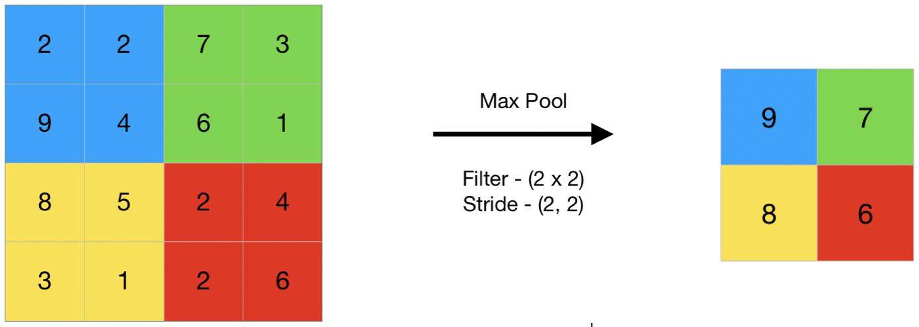
Pooling layers

Slide 5
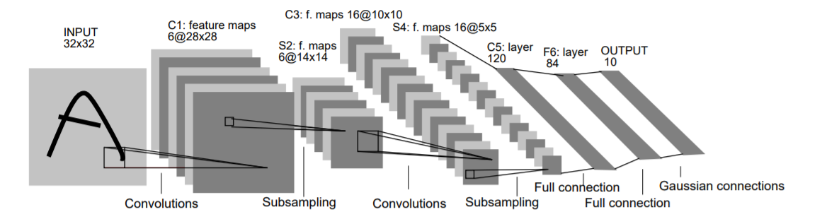
LeNet 5
Conv filters have size 5x5 and are applied at stride 1
Subsampling (Pooling) layers have size 2x2 and are applied at stride 2
[CONV-POOL-CONV-POOL-FC-FC]

Slide 6
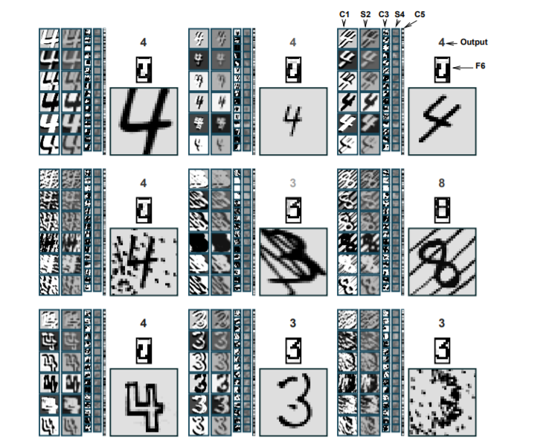
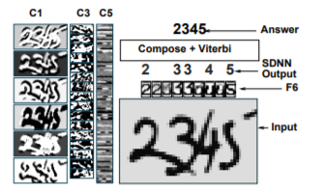
LeNet 5

Slide 7


2012
14,197,122 images
1000 categories

Slide 8
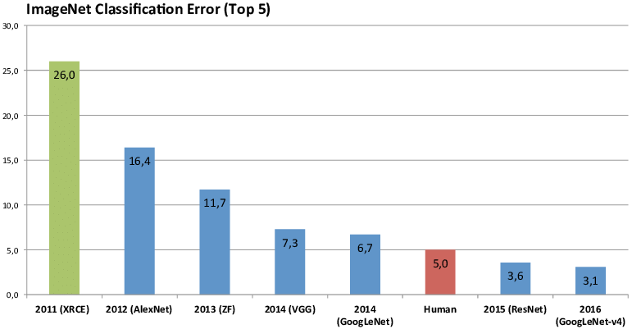

Slide 9
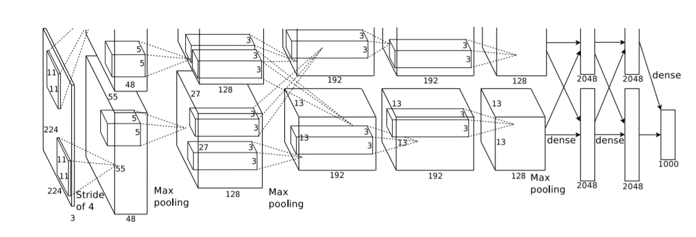
Alexnet, 2012
A single GTX 580 GPU has only 3GB of memory, which limits the maximum size of the networks
that can be trained on it.

Slide 10
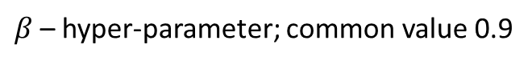
Alexnet, 2012
$$W_{o}=\frac{W_{I} −F+2P}{S}+1$$
Image size: (227, 227, 3)
First layer: 96 filter of size 11x11
What is the output volume size and the number of parameter in this layer?

Slide 11
Alexnet, 2012
$$W_{o}=\frac{W_{I} −F+2P}{S}+1$$
Image size: (227, 227, 3)
First layer: 96 filter of size 11x11
Output volume: 55x55x96
Parameters: (11*11*3)*96 ~ 35K

Slide 12
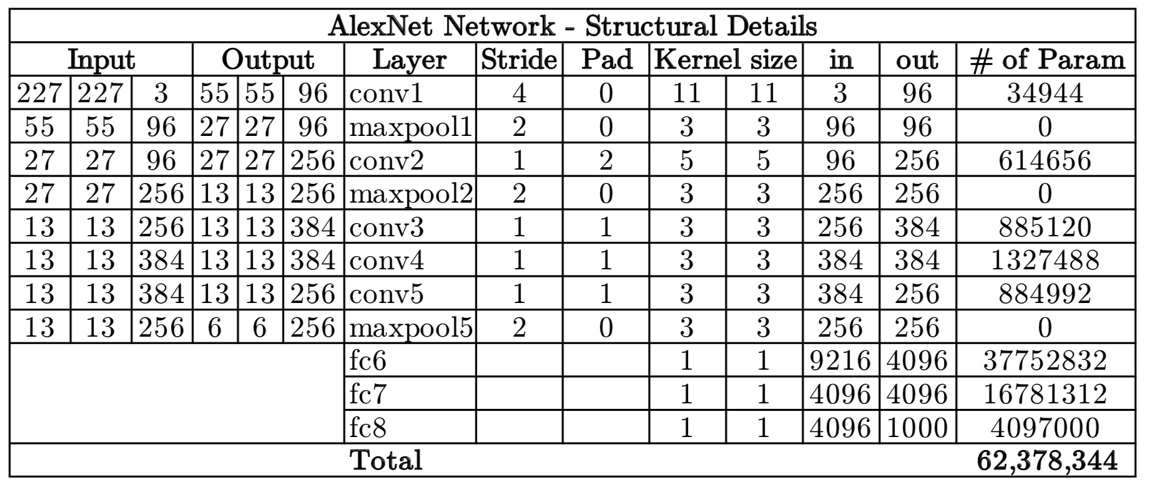
Alexnet

Slide 13
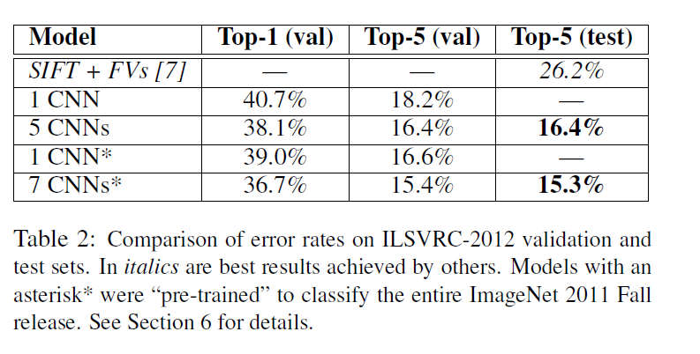
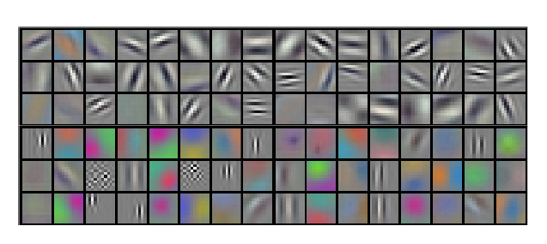
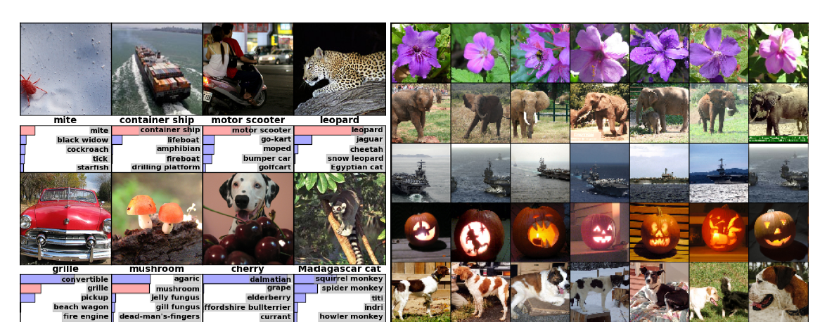
Alexnet

Slide 14
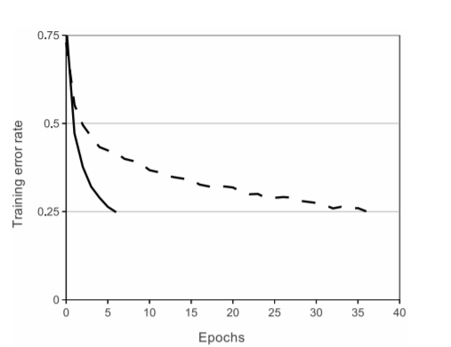
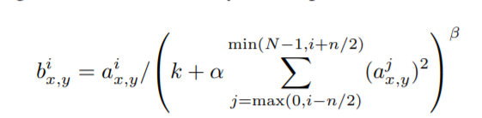
Alexnet – key features
First use of ReLU
Overlapped max pooling
Used normalization layers
Not used anymore
RELU (solid line) effect on training
vs tanh (dashed line)

Slide 15
Alexnet – key features
Training setup
Dropout 0.5
Data augmentation
Batch size 128
Gradient descent with momentum (beta = 0.9)
Initial learning rate: 1e-2, reduced manually, when a plateau was reached
7 Alexnet ensemble: 18.2% -> 15.4%

Slide 16
ZFNet, 2013
Built on top of Alexnet, improved hyperparameters

Slide 17
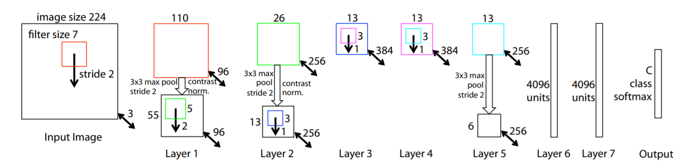
ZFNet
CONV1: change from (11x11 stride 4) to (7x7 stride 2)
CONV3, 4, 5: instead of 384, 384, 256 filters use 512, 1024, 512

Slide 18
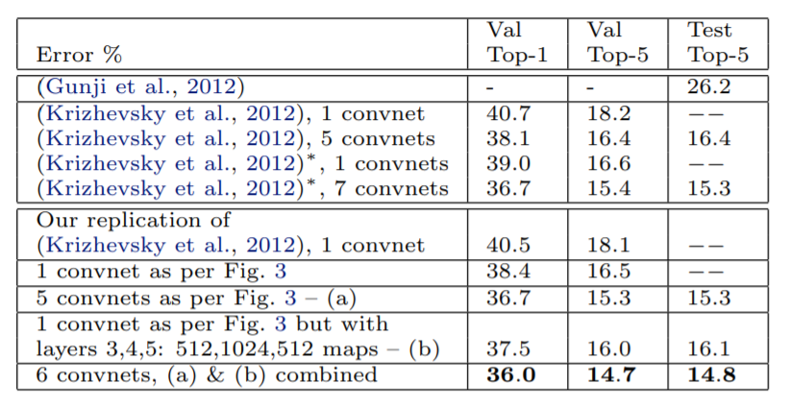

ZFNet
CONV1: change from (11x11 stride 4) to (7x7 stride 2)
CONV3, 4, 5: instead of 384, 384, 256 filters use 512, 1024, 512
ImageNet top 5 error: 15.4% -> 14.8%

Slide 19
VGG, 2014

Slide 20
VGG
Simplifies the network architectures
Always use 3x3 filters for convolutions
Always use max pooling of filter size 2x2 and a stride of 2

Slide 21
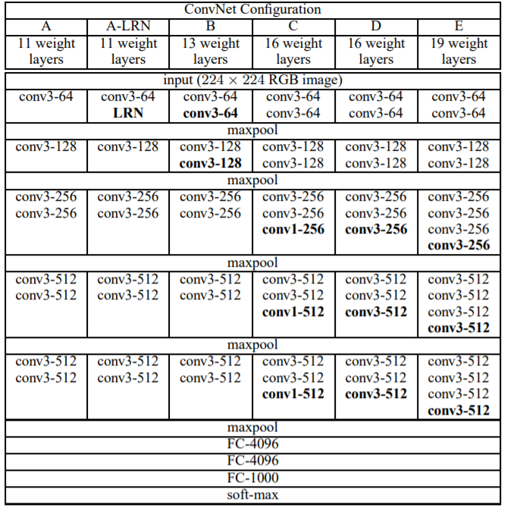
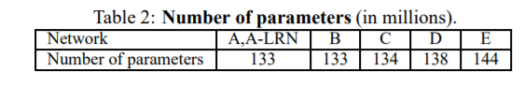
VGG
- Always use 3x3 filters for convolutions
Always use max pooling of filter size 2x2 and a stride of 2
Top 5 accuracy: 11.7 -> 7.3

Slide 22
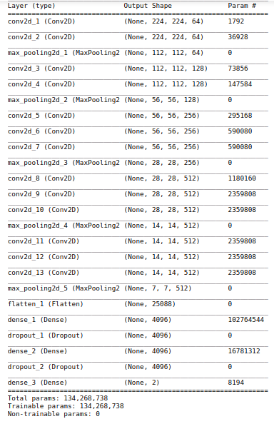
VGG

Slide 23
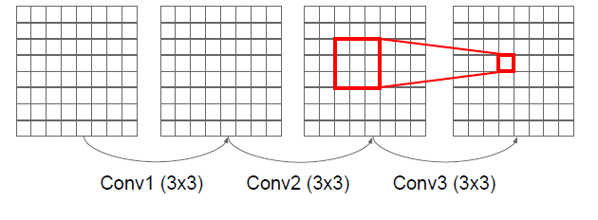
VGG
“It is easy to see that a stack of two 3×3 conv. layers has an effective receptive field of 5×5; three such layers have a 7 × 7 effective receptive field.”

Slide 24
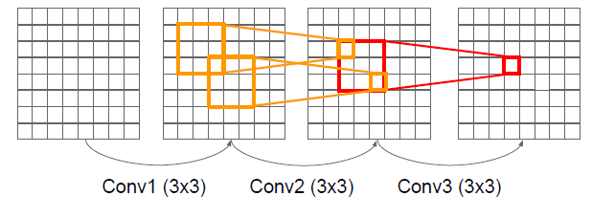
VGG
“It is easy to see that a stack of two 3×3 conv. layers has an effective receptive field of 5×5; three such layers have a 7 × 7 effective receptive field.”

Slide 25
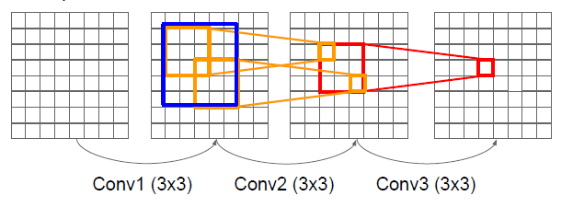
VGG
“It is easy to see that a stack of two 3×3 conv. layers has an effective receptive field of 5×5; three such layers have a 7 × 7 effective receptive field.”

Slide 26
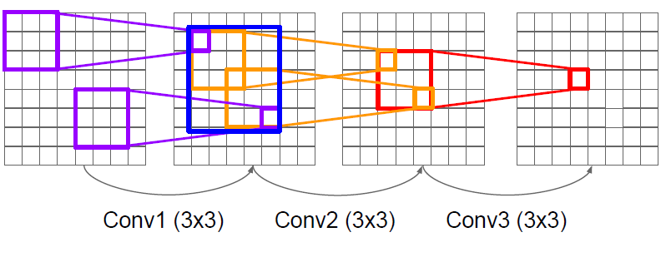
VGG
“It is easy to see that a stack of two 3×3 conv. layers has an effective receptive field of 5×5; three such layers have a 7 × 7 effective receptive field.”

Slide 27
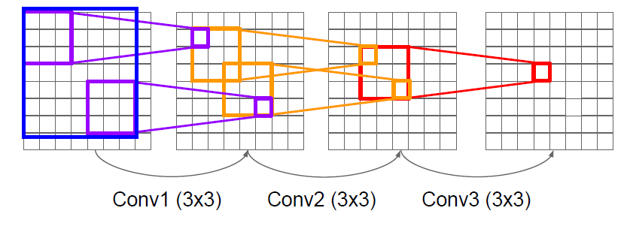
VGG
“It is easy to see that a stack of two 3×3 conv. layers has an effective receptive field of 5×5; three such layers have a 7 × 7 effective receptive field.”

Slide 28
VGG
“It is easy to see that a stack of two 3×3 conv. layers has an effective receptive field of 5×5; three such layers have a 7 × 7 effective receptive field.”
What is the effect of this replacement in terms on the number of parameters?
What about non-linearities?

Slide 29
VGG
“It is easy to see that a stack of two 3×3 conv. layers has an effective receptive field of 5×5; three such layers have a 7 × 7 effective receptive field.”
What is the effect of this replacement in terms on the number of parameters?
3*(3²C) = 27C vs 7²C = 49C
What about non-linearities?

Slide 30
VGG – key features
Did not use local response normalization layers
Use ensembles to boost performance
Use VGG 16 or VGG 19 (VGG 19 brings only a small increase in performance, but it requires more memory)
Similar training procedure as in AlexNet

Slide 31


Slide 32
GoogLeNet, 2014
8 layers
8 layers
16/19 layers
22 layers
6.7 top-5 accuracy

Slide 33
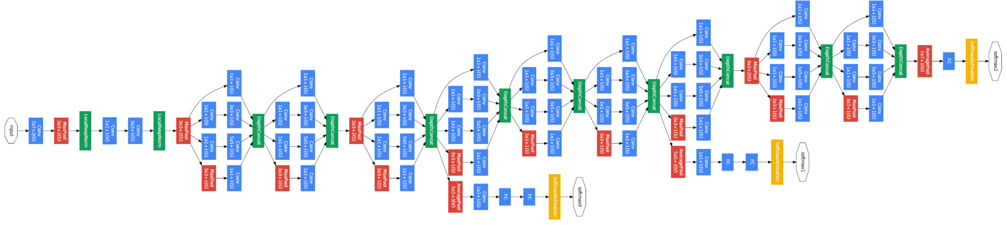
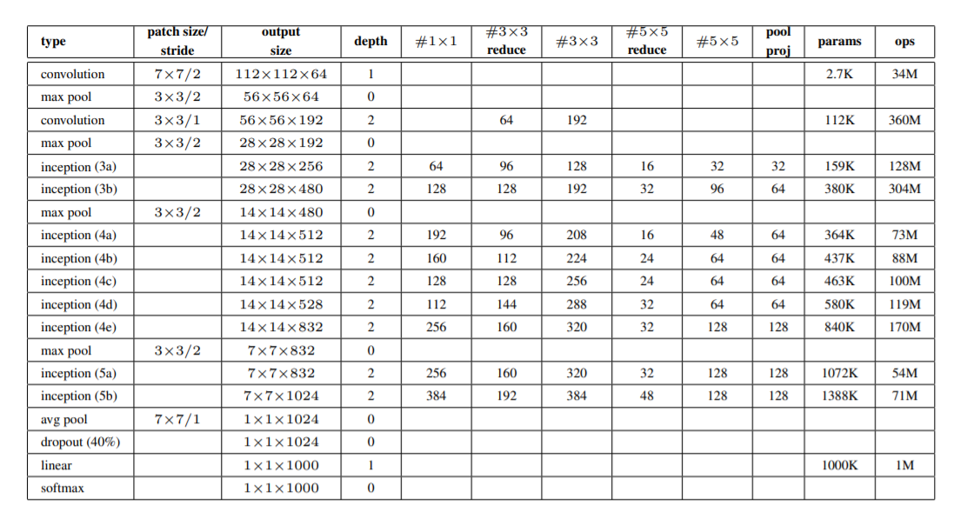
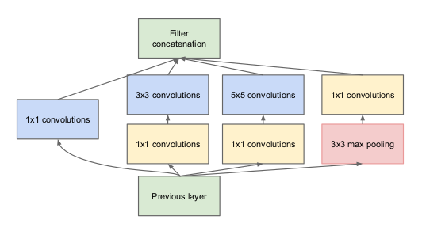
GoogLeNet
This name is an homage to Yann LeCun’s pioneering LeNet 5 network
Inception module

Slide 34
Inception module
You don’t need to ”pick” the filter sizes, instead you let the network “choose” between several values
Filters of different sizes
Pooling layer
Concatenate activations depth-wise

Slide 35
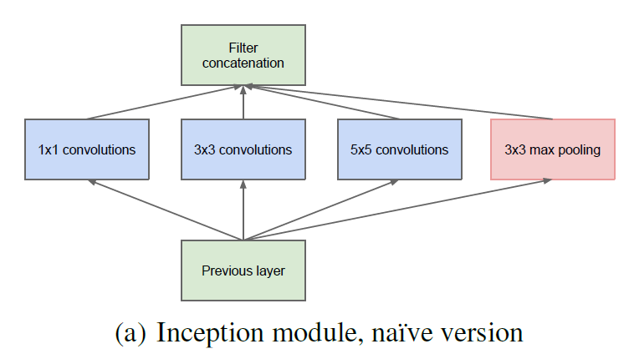
Inception module

Slide 36
Inception module
What are the output sizes of all these operations?
128
192
96
?
Input: 28x28x256

Slide 37
Inception module
28x28x128
28x28x192
28x28x96
28x28x256
128
192
96
Input: 28x28x256

Slide 38
Inception module
28x28x(128+192+96+256) = 28x28x672
28x28x128
28x28x192
28x28x96
28x28x256
128
192
96
Input: 28x28x256

Slide 39
Inception module
28x28x(128+192+96+256) = 28x28x672
28x28x128
28x28x192
28x28x96
28x28x256
128
192
96
Input: 28x28x256
[1x1 conv, 128 filters]: ? convolution operations
[3x3 conv, 192 filters]: ? convolution operations
[5x5 conv, 96 filters]: ? convolution operations

Slide 40
Inception module
28x28x(128+192+96+256) = 28x28x672 = 526848
28x28x128
28x28x192
28x28x96
28x28x256
128
192
96
Input: 28x28x256
[1x1 conv, 128 filters]: 28x28x128x1x1x256
[3x3 conv, 192 filters]: 28x28x192x3x3x256
[5x5 conv, 96 filters]: 28x28x96x5x5x256
>850M

Slide 41
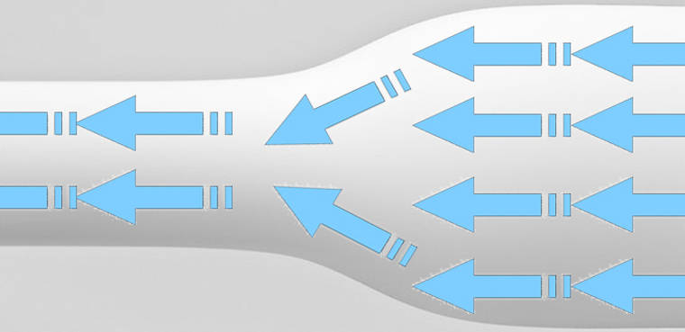
Bottleneck
Use bottleneck layers to reduce the depth dimensions of the activations
use 1x1 convolutions

Slide 42
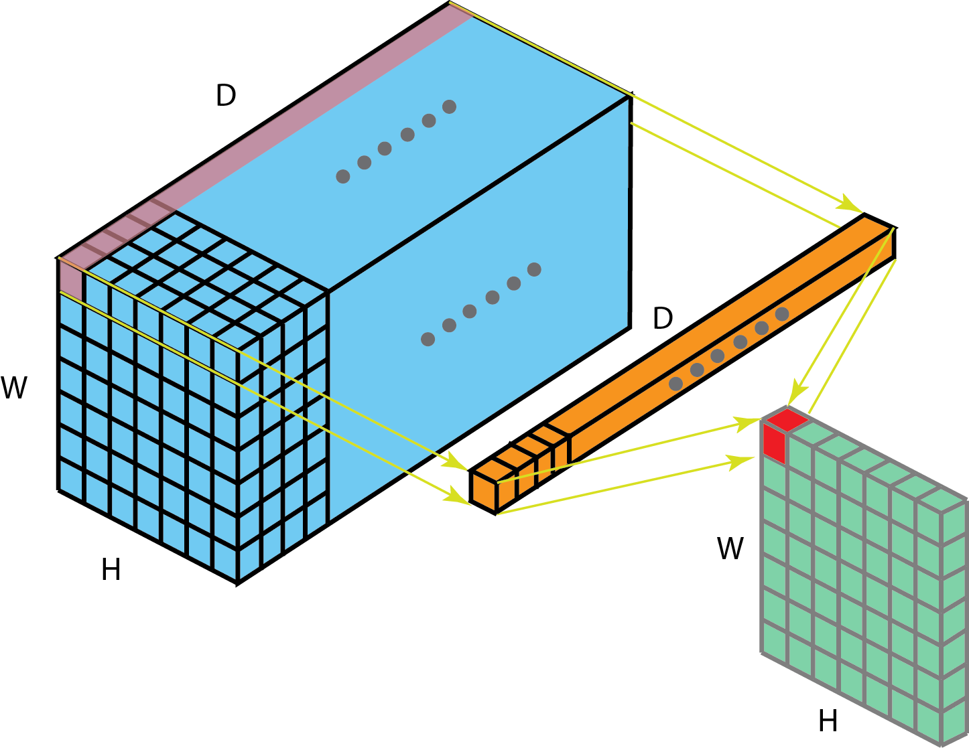
1x1 convolutions
Each filter has a 1x1xD size and performs a D-dimensional dot product

Slide 43
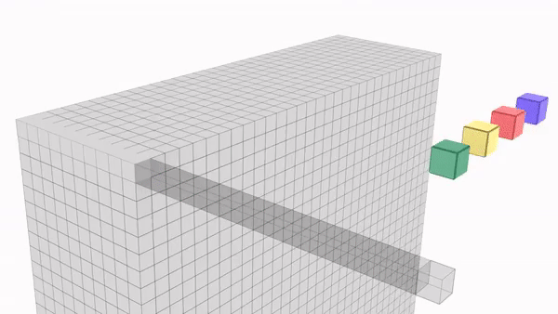
1x1 convolutions
image source : https://medium.com/hitchhikers-guide-to-deep-learning/6-introduction-to-deep-learning-with-computer-vision-3x3-is-a-lie-1x1-convolutions-9edd2baf7fd5

Slide 44
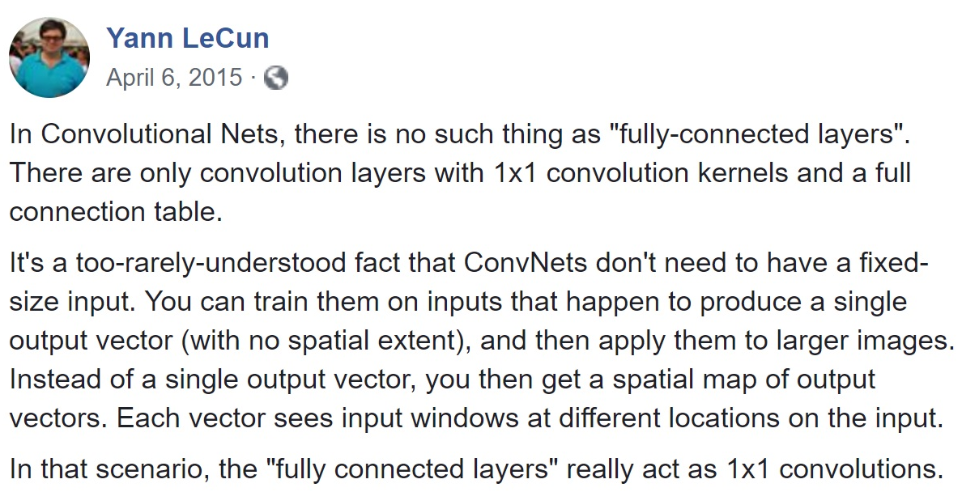
1x1 convolution

Slide 45
The real Inception module

Slide 46
The real Inception module
192
96
64
128
64
64
Input: 28x28x256
[1x1 conv, 64] ??
[1x1 conv, 64] ??
[1x1 conv, 128] ??
[3x3 conv, 192] ??
[5x5 conv, 96] ??
[1x1 conv, 64] ??

Slide 47
The real Inception module
192
96
64
128
64
64
Input: 28x28x256
[1x1 conv, 64] 28x28x64x1x1x256
[1x1 conv, 64] 28x28x64x1x1x256
[1x1 conv, 128] 28x28x128x1x1x256
[3x3 conv, 192] 28x28x192x3x3x64
[5x5 conv, 96] 28x28x96x5x5x64
[1x1 conv, 64] 28x28x64x1x1x256
>850M
358M

Slide 48
GoogLe Net
Stack Inception modules on top of each other

Slide 49
GoogLe Net
Inception modules
Classifier output removes FC layers
Stem network:
Conv – Pool – 2x Conv-Pool

Slide 50
GoogLe Net
Output layers to inject additional gradient at lower layers
AvgPool – 1x1 Conv – FC – FC - Softmax

Slide 51
GoogLe Net
Stack Inception modules on top of each other

Slide 52
GoogLe Net
Removes fully connected layers
It was found that a move from fully connected layers to average pooling improved the top-1 accuracy by about 0.6%.

Slide 53
Global average pooling Network In Network, 2014
Instead of adding fully connected layers on top of the feature maps, take the average of each feature map, and the resulting vector is fed directly into the softmax layer.
is more native to the convolution structure by enforcing correspondences between feature maps and categories (feature maps can be easily interpreted as categories confidence maps)
no parameter to optimize in the global average pooling thus overfitting is avoided at this layer
sums up spatial information -> more robust to spatial translations of the input

Slide 54
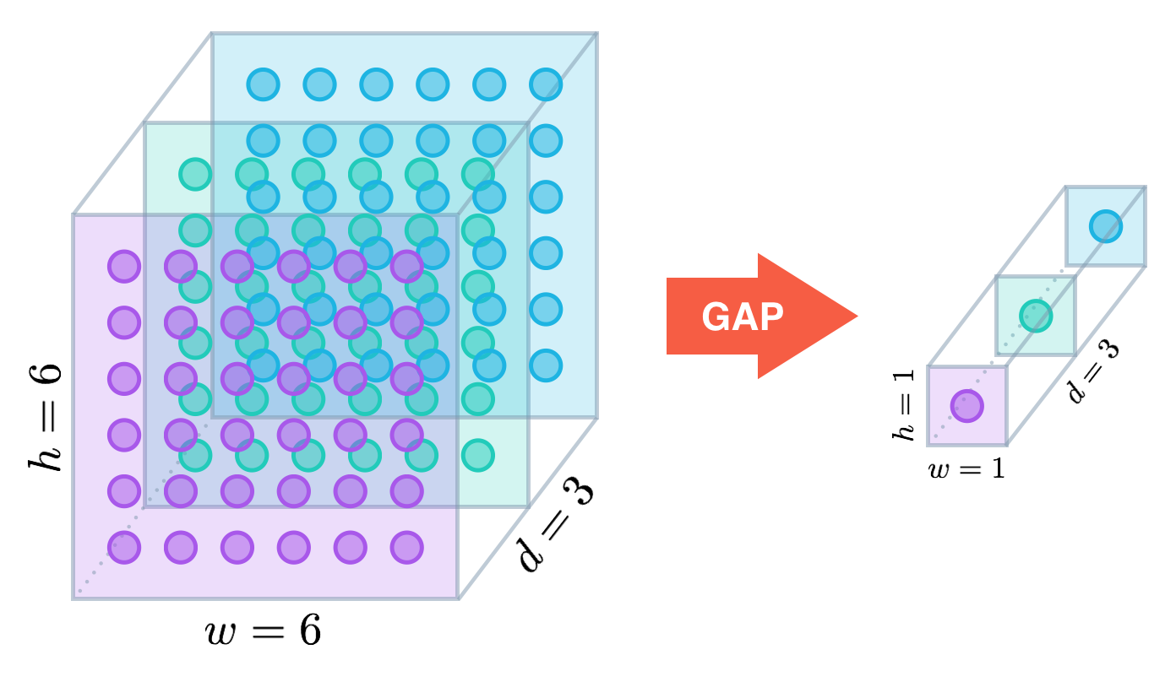
Global average pooling (GAP)

Slide 55
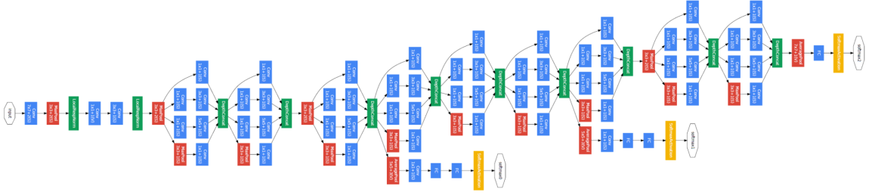
GoogLe Net
22 layers
Inception module
12x less parameters than AlexNet
Top 5 accuracy: 6.7%
Removes fully connected layers as in NIN
implementation differs in that we use an extra linear layer

Slide 56
ResNet, 2015
8 layers
8 layers
22 layers
22 layers
152 layers
6.7 top-5 accuracy

Slide 57
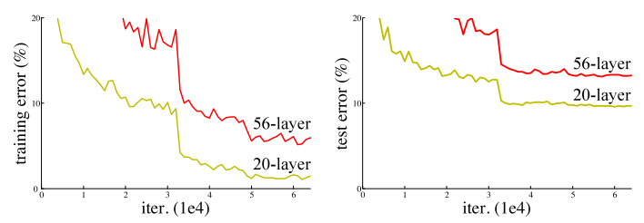
Res Net Increasing a network depth
Overfitting?
Image source: https://towardsdatascience.com/an-overview-of-resnet-and-its-variants-5281e2f56035

Slide 58
Res Net Increasing a network depth
Overfitting? NO!
Hypothesis: Deeper models are harder to optimize
Image source: https://towardsdatascience.com/an-overview-of-resnet-and-its-variants-5281e2f56035

Slide 59
Res Net
Deeper models shouldn’t hurt performance, they should be at least as good as shallower ones
Copy the learned layers from the shallower layer and set additional layers to identity mapping

Slide 60
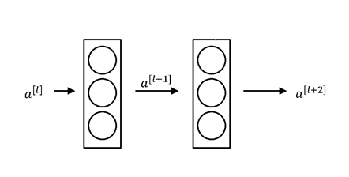
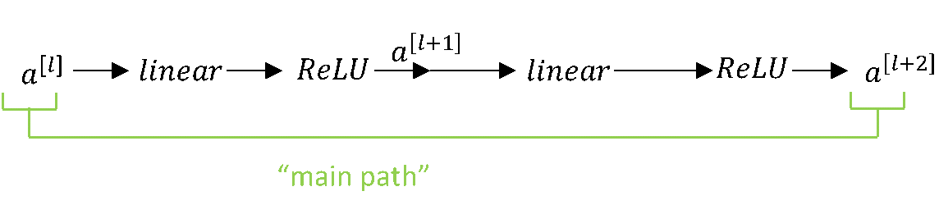
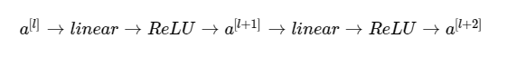
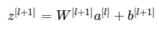
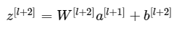
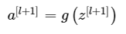
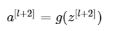
Classical neural network block
Image source: http://datahacker.rs/deep-learning-residual-networks/
Example credit: Andrew Ng

Slide 61
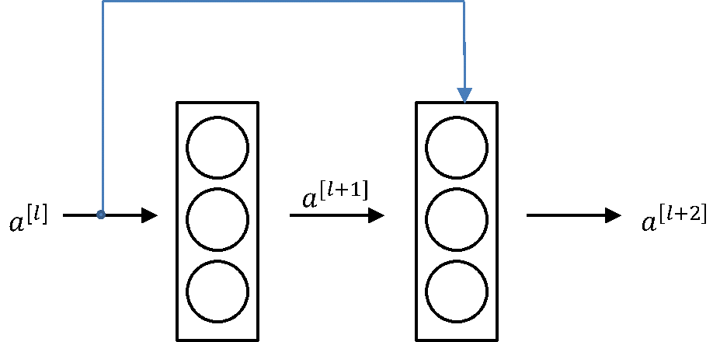
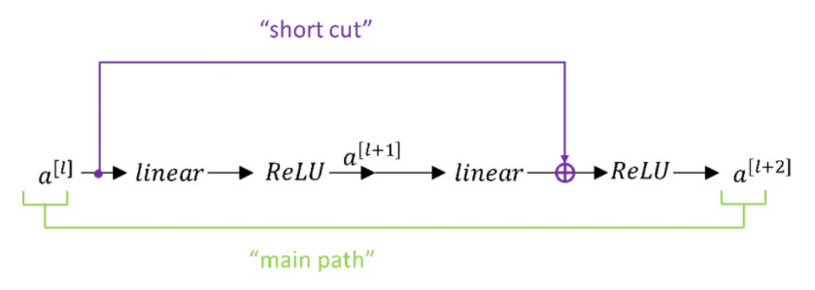
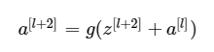
Residual block
Image source: http://datahacker.rs/deep-learning-residual-networks/

Slide 62
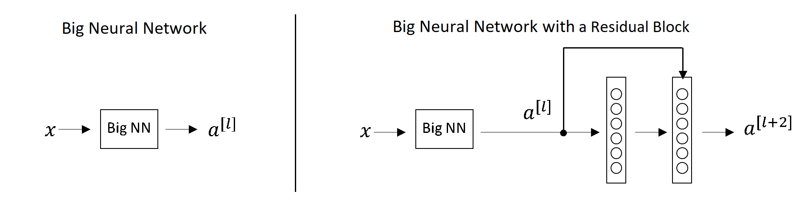
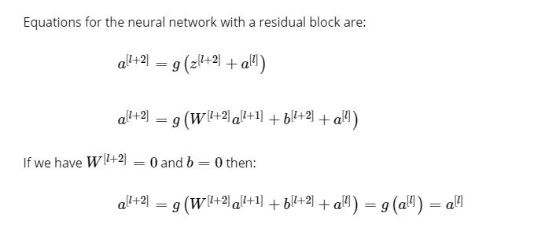
Residual block
Image source: http://datahacker.rs/deep-learning-residual-networks/

Slide 63
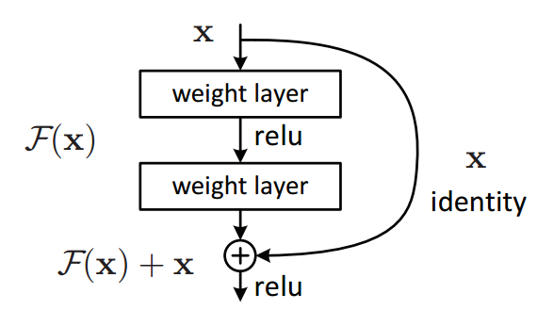
Res Net
Try to fit a residual mapping instead of directly trying to fit a desired underlying mapping

Slide 64
Residual blocks
Residual blocks
Main path
Shortcut

Slide 65
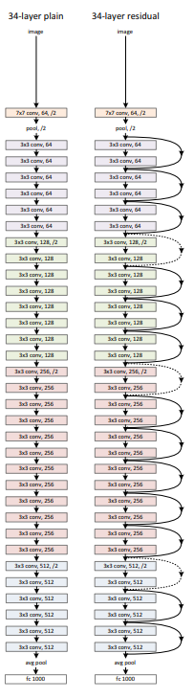
Res Net
Start with a CONV layer
Stack multiple residual blocks on top of each other
Every residual block has two 3x3 conv layers
Periodically, double number of filters and downsample spatially using stride 2
No fully connected layers

Slide 66

Res Net > 50 layers
Use “bottlenecks” just like in Inception networks
A deeper residual function F for ImageNet. Left: a building block (on 56×56 feature maps) as in Fig. 3 for ResNet34. Right: a “bottleneck” building block for ResNet-50/101/152.

Slide 67
Res Net
Allows us to train really deep networks
“Identity Mappings in Deep Residual Networks”, 2016 – trained a 1001-layer deep ResNet to outperform its shallower counterparts
Helps us with vanishing and exploding gradients
It is easy for ResNet to learn the identity function

Slide 68

Res Net
1st places on:
ImageNet detection
ImageNet localization
COCO detection
COCO segmentation

Slide 69
Res Net
- Batch Normalization after every CONV layer
- He initialization
- Momentum gradient descent (0.9)
Learning rate: 0.1, divided by 10 when validation error plateaus
- Mini-batch size 256
- Weight decay of 1e-5
- No dropout used

